Slide 1



Eclipse SDV Hackathon Chapter 4
Pitching session
TRAceON
October 6-8 2026
COPYRIGHT (C) 2026, ECLIPSE FOUNDATION

Slide 2



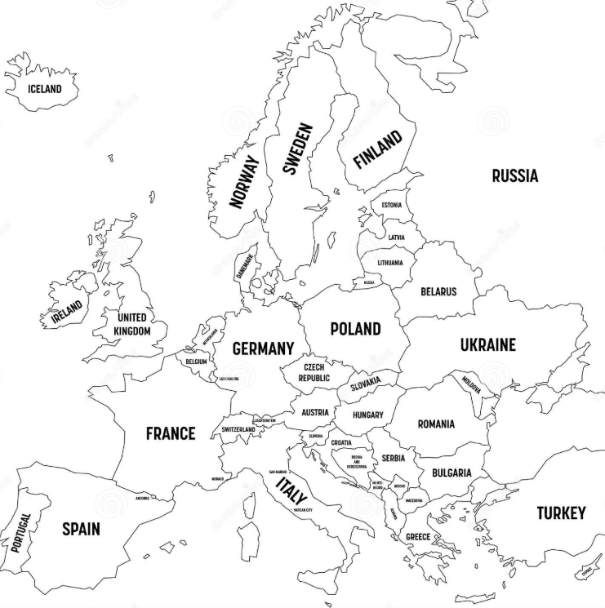






Team and Structure
Team | Contribution
Marufa Binte Mostafa | Developer
Isabella Lanes Rocha | Developer
Helge Gudmundsen | Developer
Kavyasree Sankaranarayanan Nair | Developer
Matheus Abrahao | Developer
Priyankkumar Bidya | Developer
Himank Meattle | Team Support
Copyright© Eclipse Foundation AISBL and contributors. Made available under CC-BY-SA 4.0 International.

Slide 3
The Plan
Initial Situation :
Eclipse OpenSOVD advertises the logs capability in its resource description, as defined by ISO 17978, but it does not contain an implementation. Today there is no unified way to collect and inspect logs across the vehicle network through SOVD. When an ECU reports a fault, the diagnostics engineer has no standardized interface to pull logs — which makes root-cause analysis slow and fragmented.
Solution : TRAceON implements the SOVD logs resource on top of OpenSOVD, and beyond that, it brings the developer closer to the logs generated by the vehicle regardless of their physical proximity to it. An engineer makes a single SOVD call (GET /sovd/v1/apps/{app}/logs/entries) and receives logs from the vehicle's many components — they can filter the logs on demand, configure the log request, and opt into a live SSE stream when available
Idea : Fill the real gap in OpenSOVD: deliver the provider trait, the data models and the REST routes for the SOVD logs resource (RFC 5424 and AUTOSAR DLT contexts), and prove the concept end to end with real transport to the ECU
Plan :
Fork opensovd-core and implement the LogProvider trait + models + REST routes (entries, config with GET/PUT/DELETE).
Add a live stream (SSE) over a broadcast channel.
Connect to a real ECU through two ingestion paths: uProtocol/Zenoh (RPC) and ThreadX/MQTT (hardware).
Run as separate processes (HPC + ECU) to prove the distributed architecture.
Contribute back to OpenSOVD once mature
Copyright© Eclipse Foundation AISBL and contributors. Made available under CC-BY-SA 4.0 International.

Slide 4
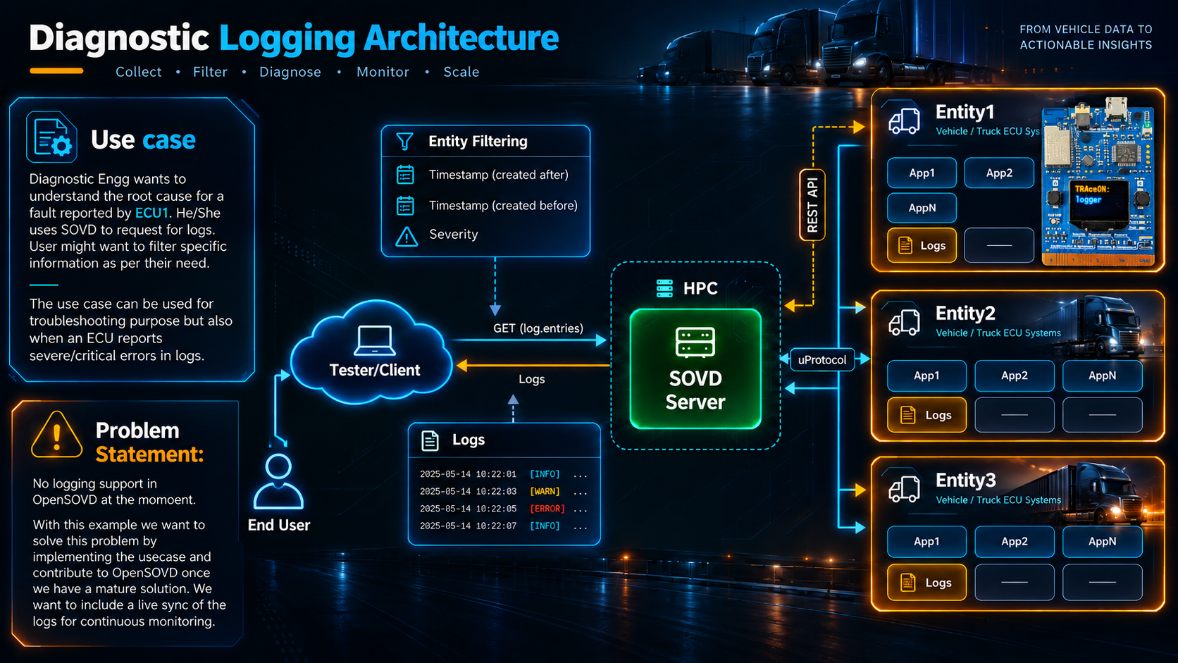
Copyright© Eclipse Foundation AISBL and contributors. Made available under CC-BY-SA 4.0 International.

Slide 5
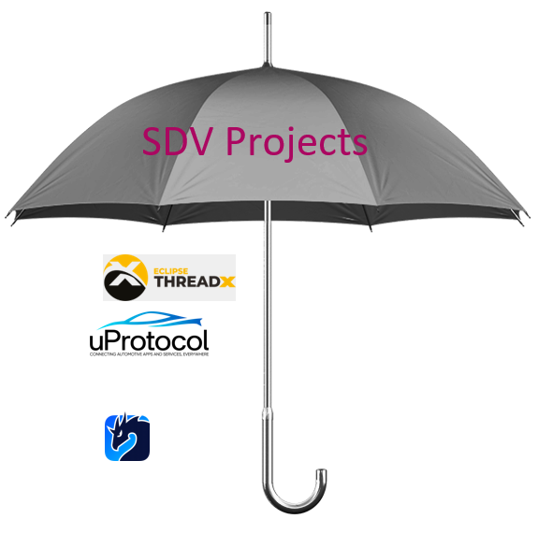
The Product / Service
What TRAceON is An implementation of the SOVD logging resource (ISO 17978-3:2026, §7.21) for Eclipse OpenSOVD. It delivers a single, standardized access point for diagnostic logs across the whole vehicle.
What is already implemented:
SOVD logs REST API — GET /entries, GET /config, PUT /config, DELETE /config under /sovd/v1/apps/{app-id}/logs/.
Live stream (SSE) — GET /entries/stream pushes new entries in real time via a tokio::broadcast channel.
Filters — by severity (?severity=) and by time window (?created-after=, ?created-before=).
Per-context configuration — severity threshold per context type (RFC 5424 or AUTOSAR DLT), applied server-side.
Two log ingestion paths:
  uProtocol/Zenoh — getLogs/getConfig/configure/resetConfig RPCs in UPAYLOAD_FORMAT_JSON over a Zenoh TCP transport, to an ECU stand- in.
  ThreadX/MQTT — MXChip AZ3166 board (Eclipse ThreadX) publishes logs over MQTT → telemetry server → SOVD server REST sink.
Two-process demo — SOVD server (HPC) + ECU as separate OS processes connected over Zenoh.
Live viewer UI — served at /ui/, with context filtering, a severity configuration panel and live SSE mode.
OpenSOVD
AutoSD
Copyright© Eclipse Foundation AISBL and contributors. Made available under CC-BY-SA 4.0 International.

Slide 6
Demo Time!!
COPYRIGHT (C) 2026, ECLIPSE FOUNDATION

Slide 7
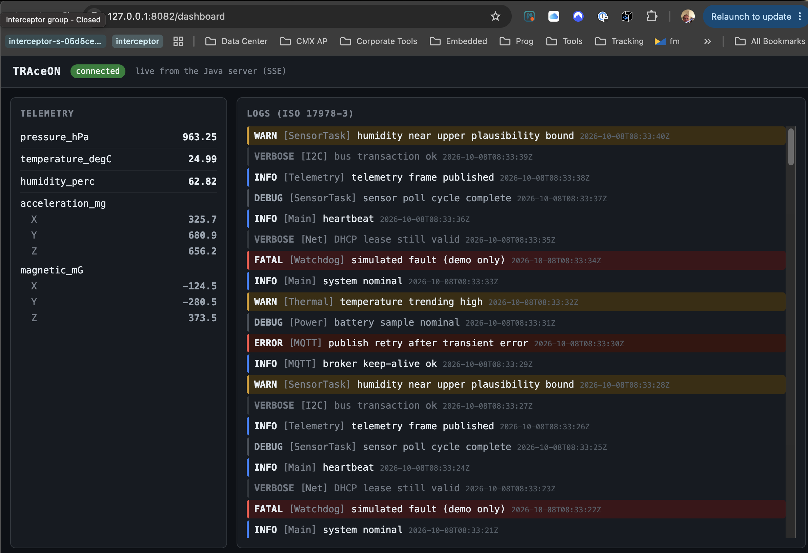
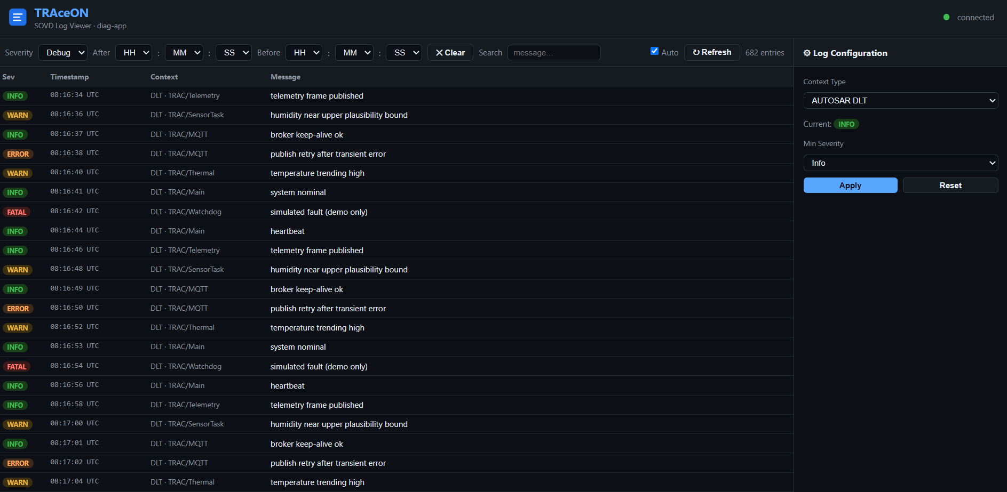
UI Log View
ThreadX Entity

Slide 8
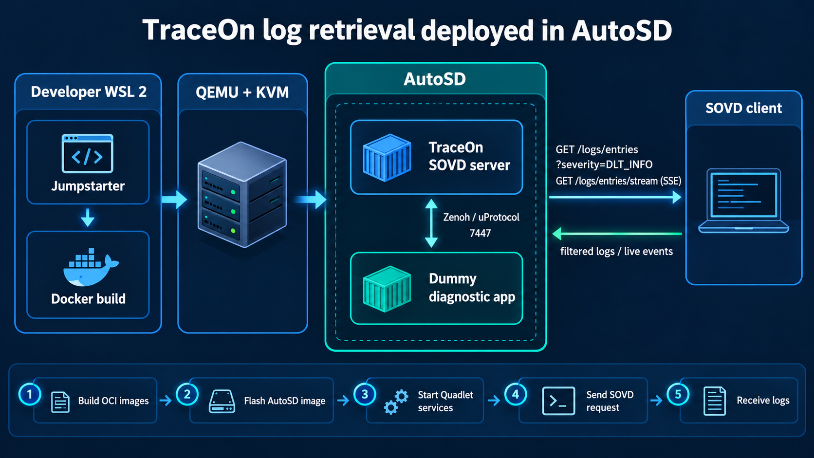

Slide 9
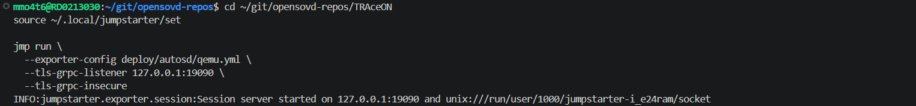
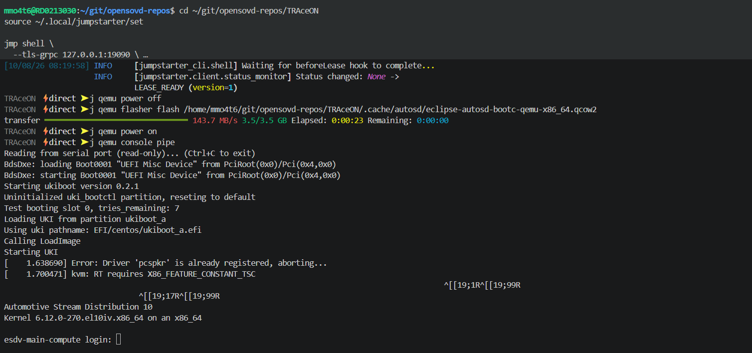

Slide 10
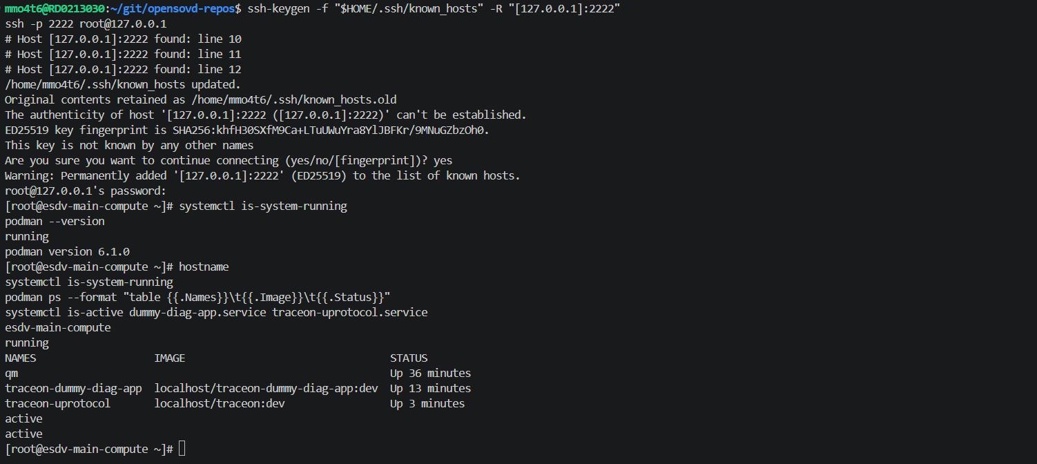
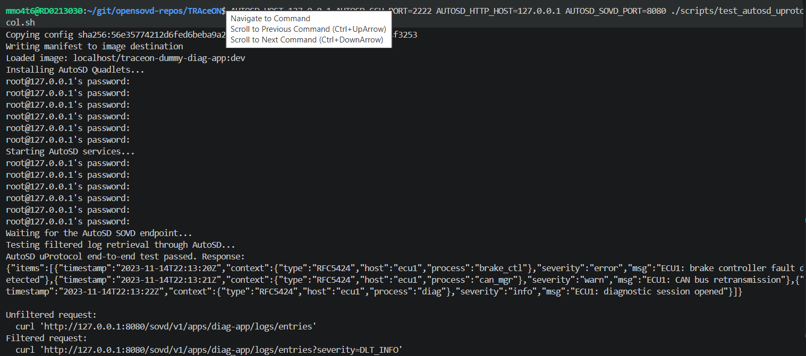

Slide 11
The Added Value
Added Value
Fills a real, documented gap: OpenSOVD declares the logs capability but does not implement it. TRAceON delivers that implementation end to end.
Unified, standardized access to logs from multiple ECUs through a single SOVD interface, speeding up root-cause analysis.
Real-time observability via the SSE stream, not just point-in-time reads.
Aligned with the SOVD standard: route structure and contexts (RFC 5424 and AUTOSAR DLT) following ISO 17978-3 §7.21.
Real, modern transport: concrete integration with Eclipse uProtocol (up-rust) over Zenoh — not just a diagram.
TRAceON fits into the existing Eclipse SDV ecosystem (OpenSOVD + uProtocol + ThreadX) instead of creating yet another silo.
Complete deployment chain can be tested in an environment closer to a real automotive target using AutoSD
It is upstream-friendly: built following OpenSOVD's code patterns, with the explicit intent to contribute back to the project
Copyright© Eclipse Foundation AISBL and contributors. Made available under CC-BY-SA 4.0 International.

Slide 12
Thank You!!
COPYRIGHT (C) 2026, ECLIPSE FOUNDATION

Slide 13
The Market & Competition
Market Potential
Vehicle diagnostics is mandatory across the entire lifecycle (development, production, after-sales, workshops, fleets).
The industry is moving toward HPC-centric SDV (software-defined vehicle) architectures, where SOVD is the emerging standard for service-oriented diagnostics, replacing legacy UDS-based approaches.
Target audience: OEMs, Tier 1 suppliers, diagnostic tooling vendors, fleet operators and embedded software teams that need standardized observability.
As an open source project within Eclipse SDV, the immediate "market" is adoption by the community and by ecosystem members already using OpenSOVD
Competitors and how we differ
ECU-specific log tools (e.g., DLT viewers, syslog): powerful, but isolated per ECU and per protocol. TRAceON aggregates them under a single, standardized SOVD interface.
Proprietary OEM diagnostic stacks: closed and expensive. TRAceON is open source and built on an open standard (ISO 17978-3 / SOVD).
OpenSOVD itself (current state): declares the logs capability but does not implement it. We are not a competitor — we are the missing implementation, designed to be contributed back.
Copyright© Eclipse Foundation AISBL and contributors. Made available under CC-BY-SA 4.0 International.

Slide 14
The Business Model | Plan and Funds
How we generate value / “sales”
Upstream contribution to OpenSOVD as the standard logging foundation, increasing adoption of the Eclipse SDV ecosystem.
Value-added services around the open source core: integration with real telemetry pipelines (DLT/journald), dashboards, support and customization for OEMs/Tier 1 suppliers.
How we implement the model
Open an issue and a draft PR on eclipse-opensovd/opensovd-core to align the trait and models with the maintainers.
Stabilize: generic per-entity routes, route tests, mock provider, SSE via standard mechanisms (subscriptions/triggers).
Evolve real ingestion (DLT/journald), multi-ECU topology and continuous health monitoring.
Eclipse openDUT integration for fleet deployment and test orchestration.
Required funds and their use
Engineering time for hardening and the upstream contribution process (review, rebase, tests).
CI and test-bench infrastructure (ECU/ThreadX hardware, brokers, Zenoh environments).
Documentation and developer-advocacy work to drive community adoption.
Copyright© Eclipse Foundation AISBL and contributors. Made available under CC-BY-SA 4.0 International.

Slide 15
Contact
Repository: TRAceON (OpenSOVD fork at open_source/opensovd-core)
Copyright© Eclipse Foundation AISBL and contributors. Made available under CC-BY-SA 4.0 International.

